Slide 1

Idea/Approach Details
Organization: Amazon Web Services
Problem Statement Title: Elderly care system
Problem Statement Number: AN319
Category: Software
Domain Bucket: Healthcare & Biomedical Devices
Team Name: Server Down
Team Leader Name: Anish Vaidya
Team Leader Contact Number:
Team Leader email Id:

Slide 2
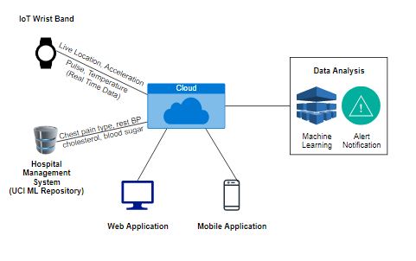
Working :
The end user registers via the Web/Mobile application
The device constantly tracks the geolocation of the individual using IoT enabled sensors
The location is displayed to the concerned person via the Cloud Service
The user gets alerted if the individual crosses the specified boundary
Additional Features :
Embedded Heart rate, accelerometer and temperature sensor
Real time monitoring of health data
Data analysis and report generation
Technology Stack :
Internet of Things (IoT)
Cloud Computing
Machine Learning
Web/Android Development

Slide 3
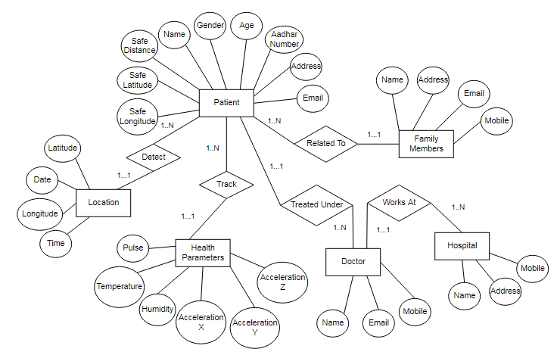
Entity Relationship Diagram

Slide 4
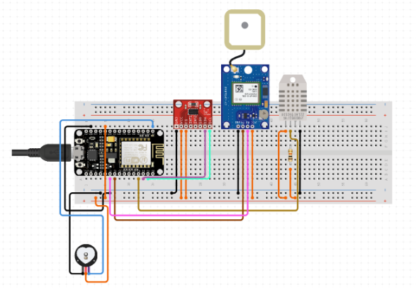
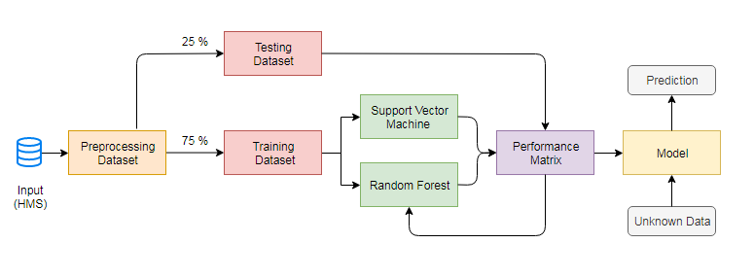
Circuit Diagram ML Workflow Diagram
GPS Module
Temperature and humidity sensor
Accelerometer
NodeMCU
Resistor
Heart Rate Pulse Sensor

Slide 5
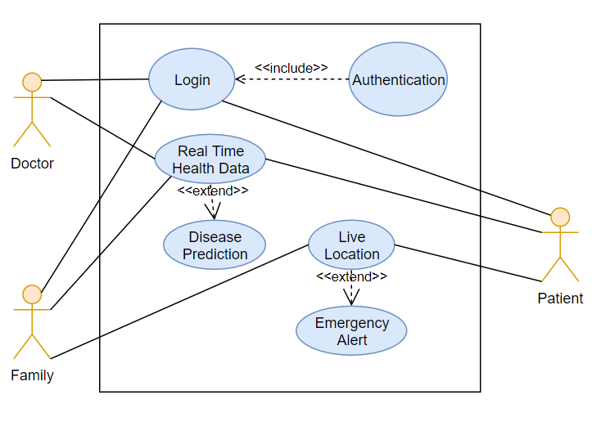
Dependencies / Showstopper :
The user must be using a proper internet connection to ensure real time transfer of data and location
The device must always be worn by the individual when alone to avoid any errors in data transmission
End Users :
Senior Citizens
Children
Specially Challenged
Benefits :
Real time data monitoring
Emergency alert

